Slide 1

Sequence Alignment with MUSCLE Analysis of arymalonate decarboxylase from Bordetella bronchiseptica and Homologs
Computational Biotechnology
S.S 2025
Leonard Jank, Bassam Ahmed Abdelrehim Ali Edrees

Slide 2
Sequence Alignment
MUSCLE = Multiple Sequence Comparison by Log-Expectation
What is sequence alignment? A method to identify regions of similarity that may indicate functional, structural, or evolutionary relationships.
Why do we use it? Essential in studying protein families, function prediction, and evolutionary biology.

Slide 3
Aryl decarboxylase
Enzyme: Aryl malonate decarboxylase (AMDase) from Bordetella bronchiseptica.
Function: Produces optically pure carboxylic acids → valuable in pharmaceutical synthesis.
Example: Intermediate production of flurbiprofen, an anti- inflammatory drug.
Relevance: Functional sites like cysteines may be critical → alignment helps compare with other AMDases.

Slide 4
Sequence Alignment

Slide 5
Sequence alignment
Sequence of arylmalonate decarboxylase from Bordatella bronchiseptica
+ different sequences for example from Verticiella sediminum, Variovorax paradoxus, Paraburkholderia megapolitana and Variovorax gossypii
→ Get sequence from UniProt and put them together in a FASTA file

Slide 6
Symbols of the alignment
Symbol | Meaning
* | Fully conserved (identical in all sequences)
: | Strong similarity (conservative substitutions)
. | Weak similarity (semi-conservative substitutions)
(space) | No similarity

Slide 7
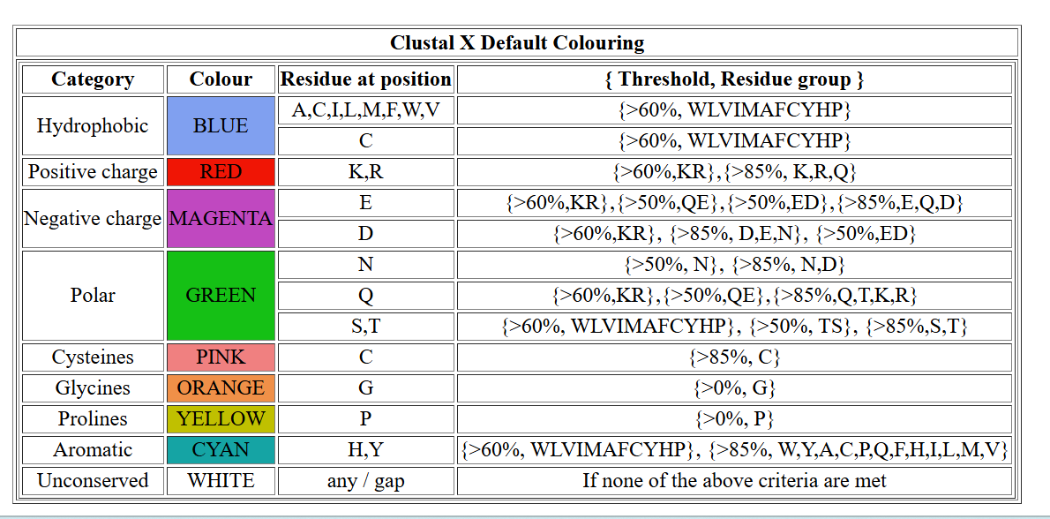
Colour Coding

Slide 8
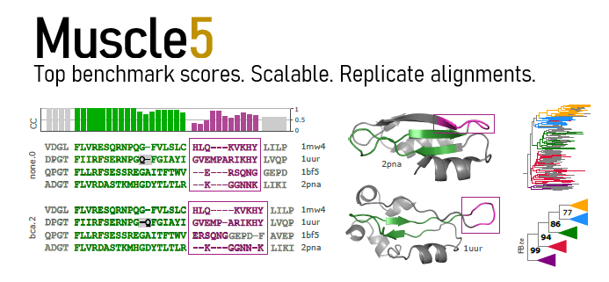
https://youtu.be/4c_5u9x1ldU?si=EZgMSKygSrXhy3R5

Slide 9
Muscle5 vs. muscle at ebi
Feature | MUSCLE5 (local) | MUSCLE @ EBI (online)
Version | v5 (2022+) | v3
Accuracy | ✅ Higher | ➖ Lower
Confidence scores | ✅ Yes | ❌ No
Large datasets | ✅ Fast | ❌ Limited
Ensemble alignment | ✅ Yes | ❌ No
Sequence number limit | ✅ Thousands | ➖ ~500 max (slow)
Works offline / in pipelines | ✅ Yes | ❌ No
Easy to use (GUI) | ❌ Command-line only | ✅ Yes (web interface)

Slide 10




